Slide 1
Data Mining for Business Harvard CSCI E-96
Ted Kwartler
https://www.linkedin.com/in/edwardkwartler/
ehk116@gmail.com

Slide 2
Agenda
Start | End | Item
 |  | Introductions
 |  | Syllabus Review
 |  | Break
 |  | Intro to R
 |  | R Installation, environment & git
 |  | Simple R Scripting

Slide 3











Ted Kwartler
MBA
Work
Teaching
Advisory Roles

Slide 4

Kshitij

Slide 5

Bik

Slide 6

Name? Where are you located?

Slide 7
Logistics
Piazza
Course Discusion Board
https://www.piazza.com/extension.harvard/fall2020/cscie9615736
Canvas
System of Record for Grades
https://canvas.harvard.edu/courses/79845
Zoom
Video
Lecture links sin Canvas site for security
Lab links shared in piazza
Labs
Get extra code help, feedback, q/a
Friday 10AM EST – 100% optional
Depending on timezone needs & interest more can be created
Getting Help
Piazza Posts Q/A & discussion
Email edwardkwartler@fas.Harvard.edu

Slide 8
On Piazza…
Where are you from?
Profession
Why did you take this course?
What do you hope to learn by the end of the course?
Tell us something interesting about yourself. Hobby? Family? Etc.
This helps your teaching staff get to know you along with what may be of interest for your learning style.

Slide 9
Agenda
Start | End | Item
 |  | Introductions
 |  | Syllabus Review
 |  | Break
 |  | Intro to R
 |  | R Installation, environment & git
 |  | Simple R Scripting

Slide 10
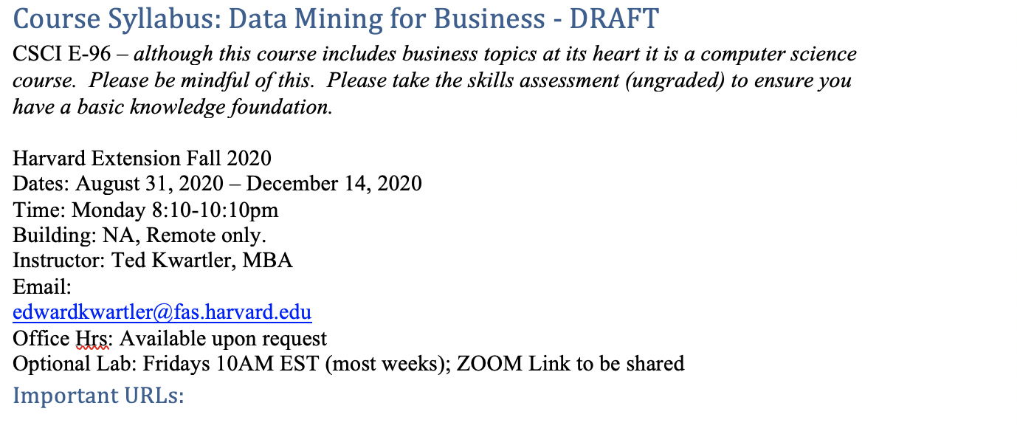
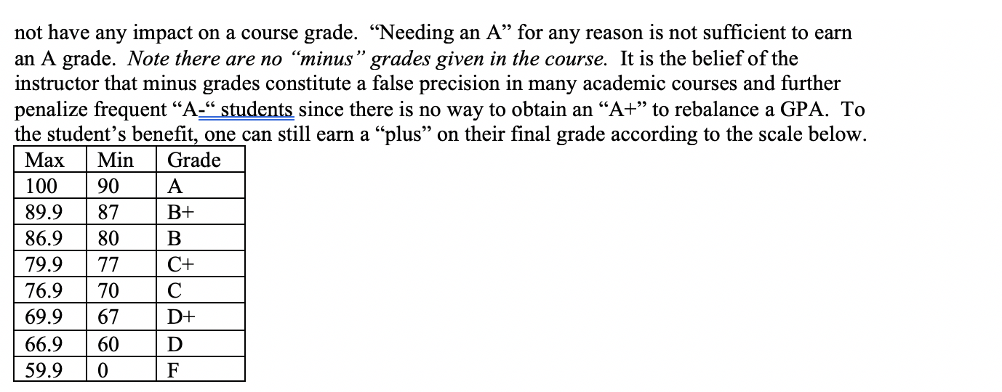
Syllabus Review

Slide 11
Community Learning Expectations
I expect:
Kindness > Cleverness
Active learning & participation
To make adjustments along the way so learning will be engaging & fun
Academic rigor
I do not expect:
Expert programmers or production quality coding skills – not really a programming course
Significant math skills – not a heavy math course
My goal for your learning experience is that the topics are:
Interesting
Applicable as a professional or future business person
Perspective building as a consumer affected by these methods
Notes:
Always new approaches and applications for DS so adjustments and active learning is paramount

Slide 12
Community Learning Expectations
The class expects (of the instructor & cohort):
…
…
…
The class does not expect:
…
…
…
The class hopes learning this material will be:
…
…
…
Although this is rhetorical, reflect on what you can contribute to make this the BEST course you have ever taken.
Notes:
Piazza is not customer service
Respect is expected among cohort and instructors

Slide 13

Some motivation
Focus on your learning outcomes
Don’t focus on your grade
You own the level of effort & engagement in your learning
I am focused on your learning outcomes
I don’t care if you need a specific grade to graduate
I take my role seriously mirroring your effort & engagement to support learning
If you are struggling, ask Prof help, attend labs, request office hours, email or even smoke signals, whatever it takes to succeed.

Slide 14

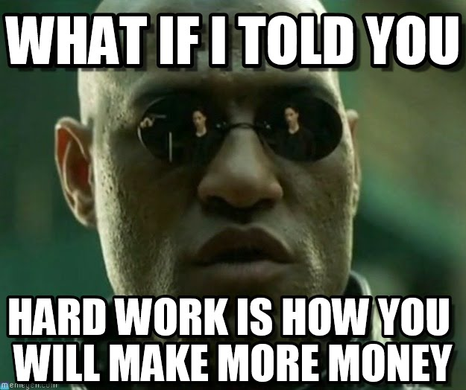

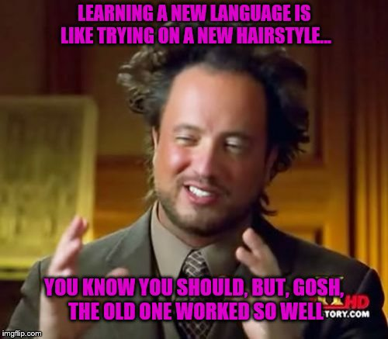
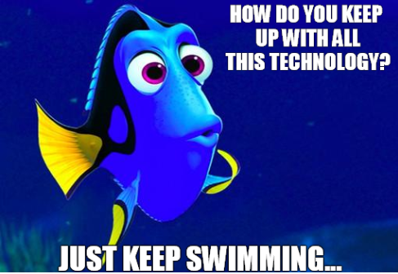
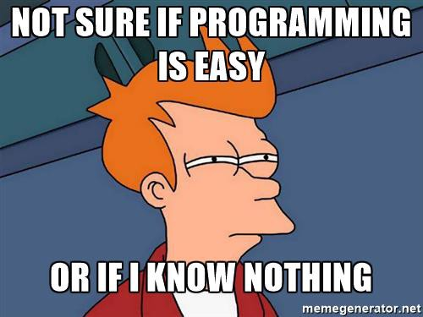
Your professor loves memes.

Slide 15
Agenda
Start | End | Item
 |  | Introductions
 |  | Syllabus Review
 |  | Break
 |  | Intro to R
 |  | R Installation, environment & git
 |  | Simple R Scripting

Slide 16
Intro to R
Learning Objectives
What is R?
What is R Studio?
Scripting Structure in this course
Why? This ensures a basic fluency before the course really starts.

Slide 17

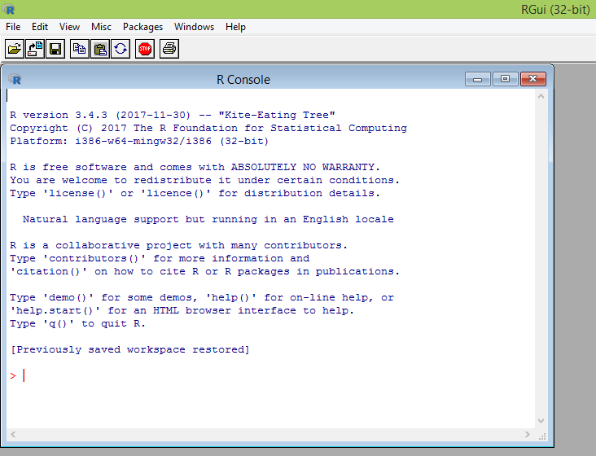
What is R?
Flexible
Open source
Academic & growing in industry
Language agnostic, SQL, Weka, C, Fortran, Java etc
R is a language & environment for statistical computing and graphics. It is the most popular statistical software in circulation today and is used by more than 2 million data scientists & statisticians worldwide.
How Companies Use R to Compete in a Data-Driven World, Data-informed.com

Slide 18

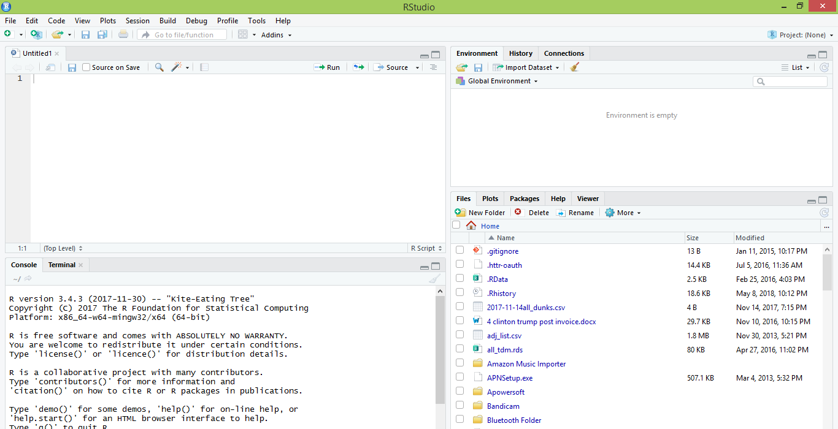
What is R Studio?
IDE – Integrated Development Environment
Adds additional functionality e.g. git, shiny projects, markdown templates
R studio is the most popular IDE for R although there are others & you don’t actually need it to execute R code.

Slide 19
What is the relationship between R & R studio?
Nice interface & additional functionality for faster programming, analysis & production.
Statistical & graphing software
R Studio sits atop of the installed R version. Without base R, R studio cannot function. By programmatically accessing base R, R Studio improves the interface and functionality.

Slide 20
R Studio has four main panes
Scripting
Environment
Commands are written & adjusted here then executed in the console. Then saved for future quick execution.
List of objects & values
e.g. loaded “excel” files
Files, Plots, Packages, Help
Console
Find files, load packages, see visualizations and quickly find help
Execution of scripts and commands, data exploration and code results
R Studio works on Linux, Windows and iOS.

Slide 21
R: Where is it being used?
Media
Google
Facebook
Twitter
Foursquare
Kickstarter
New York Times
Economist
Services
Zillow
Trulia
eHarmony
DataSong
PredictWise
Nationwide
Finance
Lloyd’s Bank
Credit Suisse
American Century
Australia and New Zealand Banking Group
Technology
SAS
Oracle
IBM
Teradata
Coursera
SAP
DataCamp
Alteryx
TIBCO
OneTick
Amazon
Google
Microsoft
U.S Government
Food & Drug
Administration
National Weather
Service
National Institute
of Standards
in Technology
R is ubiquitous in various industries used for analysis, prototyping and visualization. However, more often python is used in production environments.

Slide 22
Ok, it’s awesome but…
Pros
Cons
VERY extensible
10K+ packages
Built by stats, made for stats
Free, open source
Cutting edge
Diverse applications
Outstanding graphical capabilities
Large community-based help
Tough to do “big data”
In memory data constraints w/o extra effort
Official documentation is terse
Not as polished as a commercial application
Slow compared to lower level languages
Production worthy apps can be difficult to create
Large community-based help

Slide 23
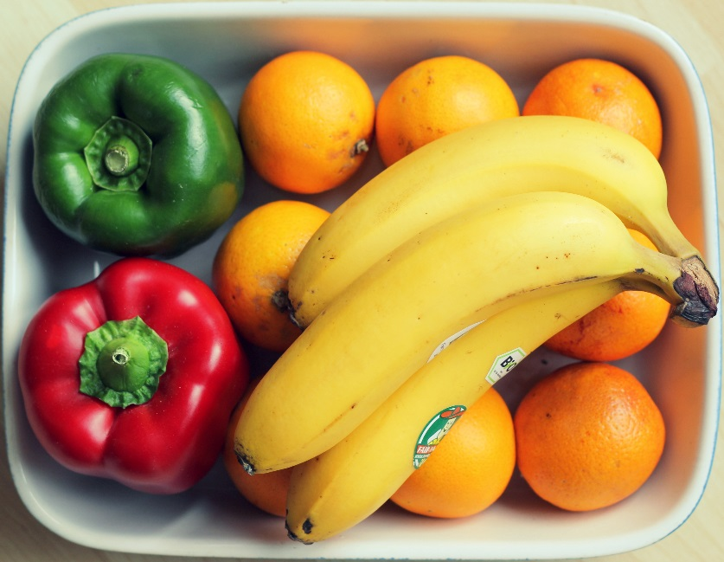
A basic R workflow
Let’s eat a banana for breakfast. Where is the fruit?
setwd(‘ted/fruit/basket’)
The item of interest needs to be in the “working directory”

Slide 24
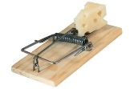
R Trap!
WINDOWS (local laptop):
In setwd() the slashes have to be switched (or “escaped”)!
setwd("~/desktop")
> setwd("~\desktop")
Error: '\d' is an unrecognized escape in character string starting ""~\d"

Slide 25


R uses functions, libraries & objects
Found the fruit basket! What tools do I need?
setwd(“ted/fruit/basket”)
library(knife)
library(peel)
Change R into a breakfast preparing machine with specialized libraries.

Slide 26

Another trap!
Before loading a library use
install.packages(“name of package”).
You only need to do this once per environment
But, will need to repeat it w/each new environment!

Slide 27
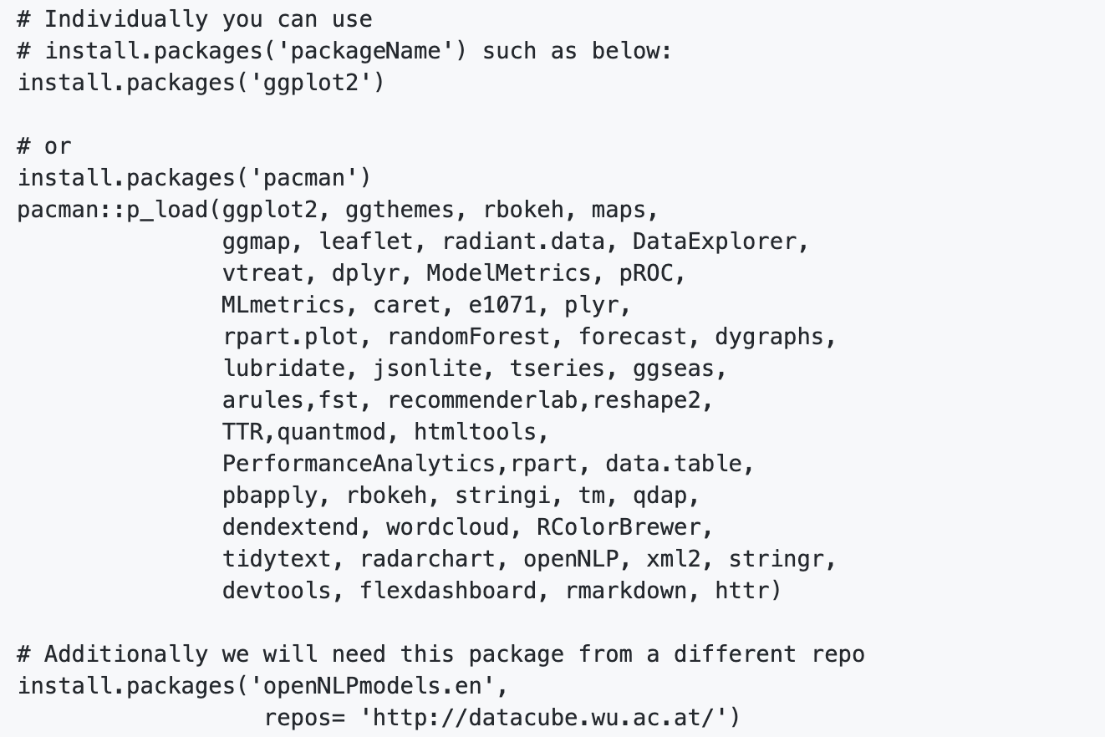
The course readme has the packages to install.
Don’t install them now, it takes awhile.

Slide 28

R uses functions, libraries & objects
Now R is a cutting & peeling machine, let’s pick our fruit.
setwd(“ted/fruit/basket”)
library(knife)
library(peel)
banana <- read.fruit(“Banana.csv”)
Must
Be In the working directory or full path declared
Be inside quotes
Have correct capitalization, spacing & spelling matter.
R now has the object called banana in memory ie “opening a spreadsheet”

Slide 29

What if my file is Excel or ???
R can open many files types with different functions
CSV
Excel
SaS
SPSS
Rds, rda, fst etc
Connections
Databases (SQL, mongoDB)
S3 Buckets
APIs
Recommendation: to get started stick with CSV. Most software can export CSV. Most class files are CSV.

Slide 30
R uses functions, libraries & objects
Function
Input
Output
R uses predefined functions to accomplish things.

Slide 31

R uses functions, libraries & objects
halfBanana <- cutinhalf(banana )
Output
Function
(
Input
)
“ <- ” is the assignment operator

Slide 32


R uses functions, libraries & objects
setwd(“ted/fruit/basket”)
library(knife)
library(peel)
banana <- read.fruit(“Banana.csv”)
halfBanana <- cutinhalf(banana )
halfBanana <- peel ( halfBanana)
Output
Function
(
Input
)
Results of an object can be used in the next function.

Slide 33
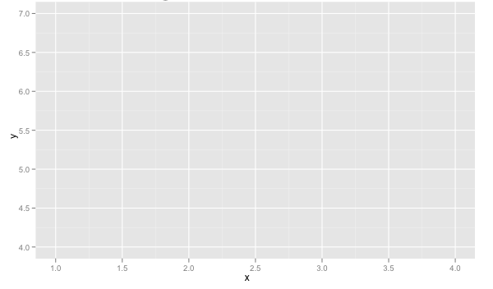
R uses functions, libraries & objects
setwd(“ted/fruit/basket”)
library(knife)
library(peel)
banana <- read.fruit(“Banana.csv”)
halfBanana <- cutinhalf(banana)
halfBanana <- peel(halfBanana)
plot(halfBanana)
Function
(
Input
)
You don’t always have to declare an output object & you can also save items to disk.

Slide 34






Workflow review
1
Use setwd() to point to your files & where to save outputs.
2
Load some customized libraries with library() for your specific analysis and methodology. Sometimes we will also create customized functions not in a library to aid our analysis.
3
Read in the file so the object is “in-memory” with read.csv() or similar.
4
Apply a function(s) from a library to adjust or create new objects in memory. The pseudo code for this is:
object<-function(applied to object)
5
Consume the results by saving, plotting etc.

Slide 35
Agenda
Start | End | Item
 |  | Introductions
 |  | Syllabus Review
 |  | Break
 |  | Intro to R
 |  | R Installation, environment & git
 |  | Simple R Scripting

Slide 36
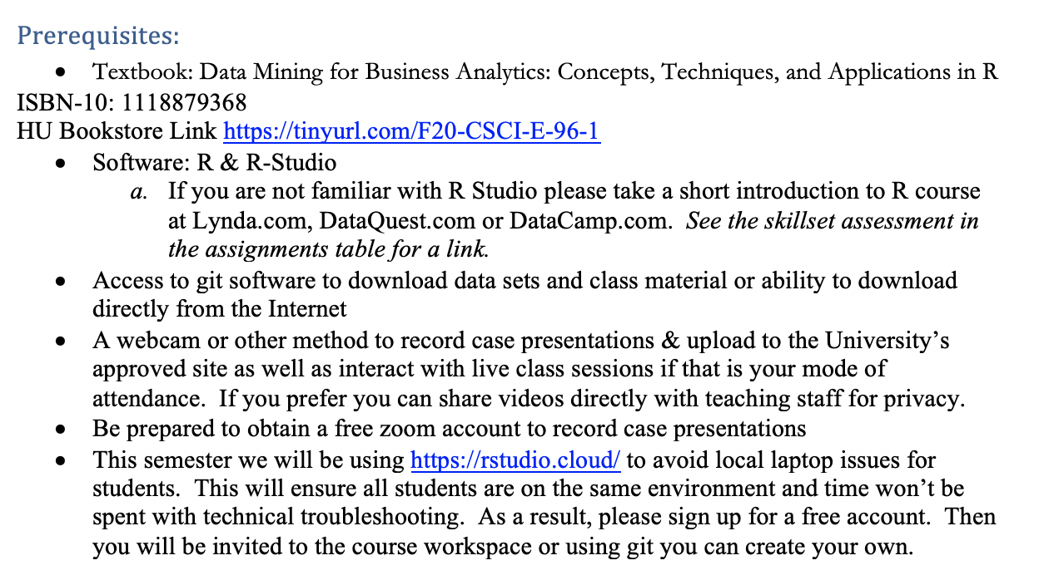
Install R Studio & Git
If you don’t have it installed yet, please do so now!! The rest of the course and your learning utilizes R Studio.

Slide 37

R Studio Cloud
Also, create an account for RStudio Cloud: https://rstudio.cloud .
Once you’re logged in, use (click) “Your Workspace” or create a new space.
Click the “New Project” button.
Change the Title of the Project as you wish.
In Console, type install.packages(“rmarkdown”) and press the Enter button
Uploading and Downloading Files in RStudio Cloud
See https://support.rstudio.com/hc/en-us/articles/200713893-Uploading-and-Downloading-Files

Slide 38
R Studio

Slide 39
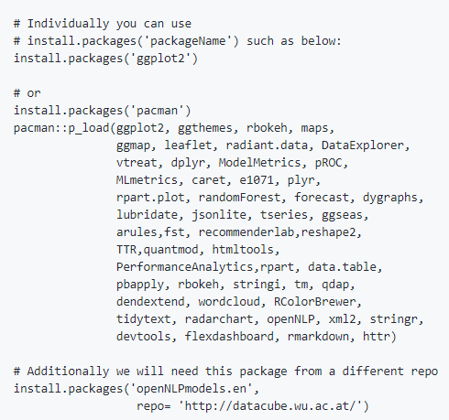
Libraries to install…we cover a lot in this course!
Please review the readme file of the Student repo!!

Slide 40
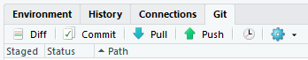
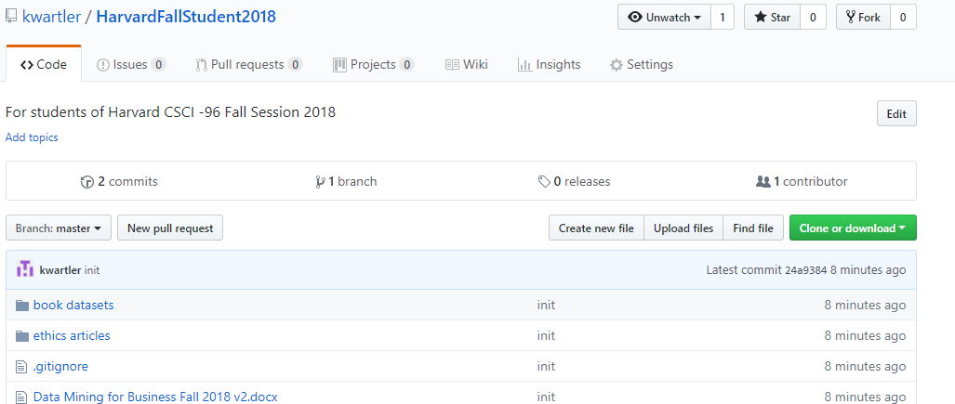
To get scripts, ppts & data use the class repo
https://github.com/kwartler/Harvard_DataMining_Business_Student
If you have git software, when do a “git pull” in Rstudio.
Alternatively you can download a zip of the repo on github.com but this can be cumbersome with file updates.

Slide 41


Turning in Files
For all files submitted, please use
LASTNAME_caseI_script.R (can be more than 1 to keep items straight)
LASTNAME_caseI_presentation.pptx
The first slide includes your name and the link to the video presentation.
In the past classes would share their video links for feedback and encouragement. This is encouraged, but optional.

Slide 42
Agenda
Start | End | Item
 |  | Introductions
 |  | Syllabus Review
 |  | Break
 |  | Intro to R
 |  | R Installation, environment & git
 |  | Simple R Scripting

Slide 43
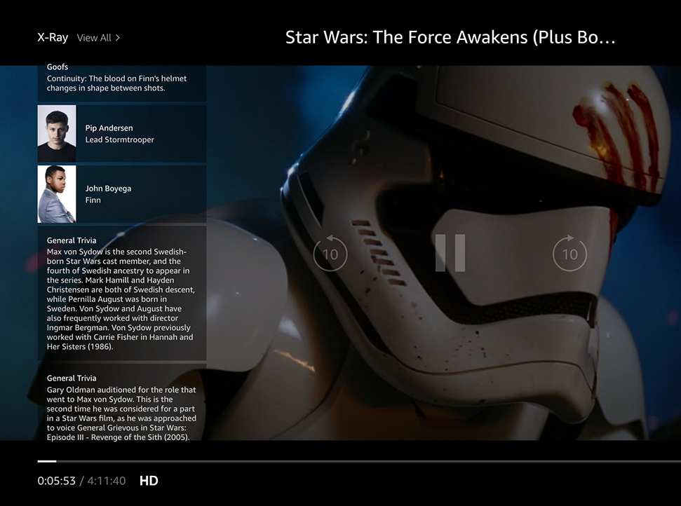
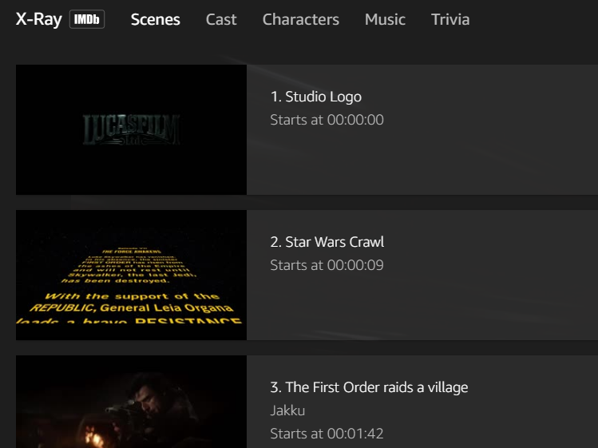
Amazon X-Ray: A basic R-Script
Left Hand Screen:
Actor Information & Trivia
Center “Pop-over” Screen:
Scenes, Cast, Characters, Music & Trivia

Slide 44

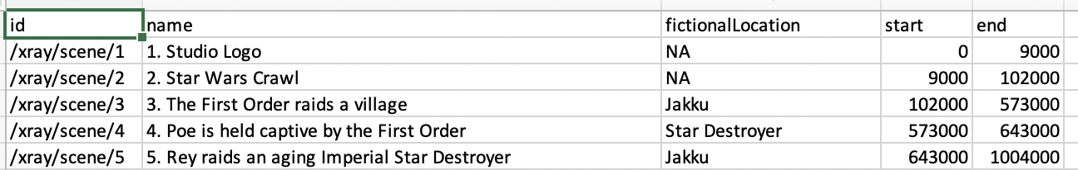
Let’s practice!
Open A_demo_script.R
Learning Outcome: Following a consistent workflow, load, clean, & analyze real data with multiple data types to establish basic familiarity.

Slide 45
Lists, a little bit more complex
Now operations are applied to each element not just 1 data frame.
30 Songs in a “list”
LIST
Song
Song
Song
Song
…
…
…
Song
Song
Don’t worry if this is intimidating…at this point I don’t expect you to really know how to do this. Merely get into R, run some code, and conceptually understand the flow.

Slide 46
Lists, a little bit more complex
Now operations are applied to each element not just 1 data frame.
30 Songs in a “list”
LIST
2500 total lines analyzed among 30 songs
Song 1: At 4 seconds, 7 words were spoken
Song 1: At 10 seconds 12 total words (7+5)
…
Song 30: At 4.6 min, 862 total words spoken
Functions applied in series
function()
Song
Song
Song
Song
…
Grab the last line total for each song
30 songs
Song 1: ends at 3m with 709 total words spoken
…
Song30: ends at 4.67m with 863 words
…
…
Song
Song
Don’t worry if this is intimidating…at this point I don’t expect you to really know how to do this. Merely get into R, run some code, and conceptually understand the flow.

Slide 47
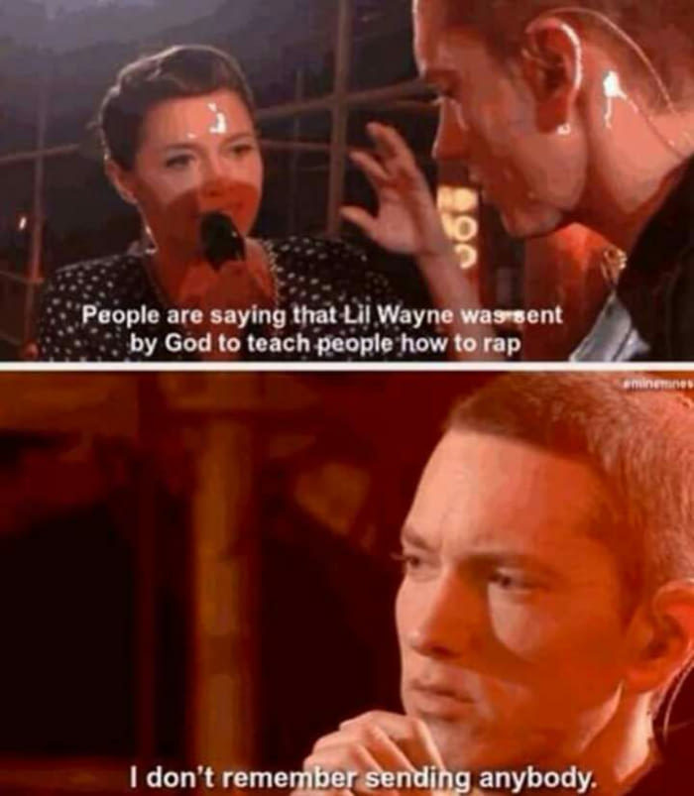
Let’s practice!
Open B_RapSongs.R
30 Songs in a “list”
LIST
Song
Song
Song
Song
…
…
…
Song
Song
Learning Outcome: more R scripting!

Slide 48
Housekeeping , Reading & Homework, recommended
Make sure you have R Studio Installed
Sign up at RStudio Cloud
If local, Recommended to install Git locally for “git pull”
Connect your local to the class repo
Chapter 1 & Chapter 2
1. Piazza introduction post (slide 7, assigned as part of class participation)
2. C2.1 Data Mining Techniques
3. C2.2 Data Partition
4. C2.3 Data Sample
5. C2.4 Modeling Steps

